Slide 1
AutoCad 2021
د. وميض تركي محمد

Slide 2
في نهاية هذا الدرس يستطيع الطالب أن يتعرف على:
التعامل مع الكتل -2- Blocks

Slide 3
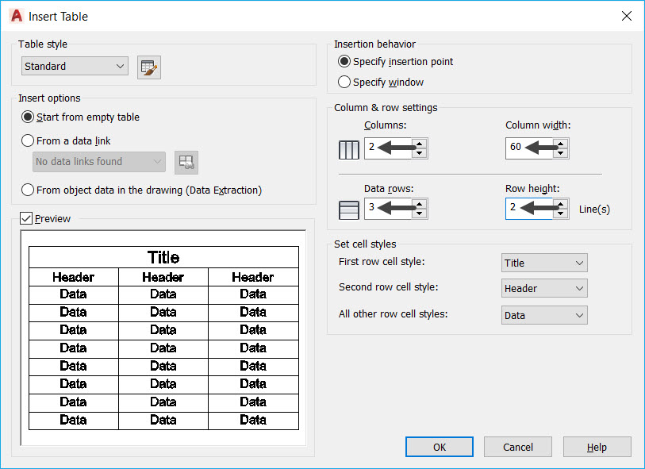
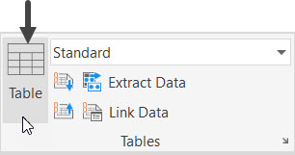
التعامل مع الكتل Inserting Blocks in a table
You can insert blocks in a table and fit inside the table cells. Note that you cannot insert Annotative blocks in a table.
Example: Click on Annotate → Table → Table from the Ribbon to display Insert Table dialog box.
• Insert the values in the dialog box.
→
Click OK and click anywhere in the drawing area to define the insertion point of the table.
• After inserting the table, you can change its size (width and height) uniformly by dragging its corner grip.

Slide 4
التعامل مع الكتل Inserting Blocks in a table
Enter the names in the table cells.
Select the first cell in the Symbol row and right-click
Select Insert > Block from the shortcut menu; the Insert a Block in a Table Cell dialog box appears.
In the Insert a Block in a Table Cell dialog box, select block name.
• Set Overall cell alignment to Middle Center.
• Click OK; the block symbol will be placed in the selected cell.

Slide 5
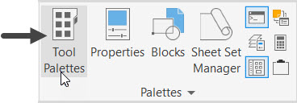
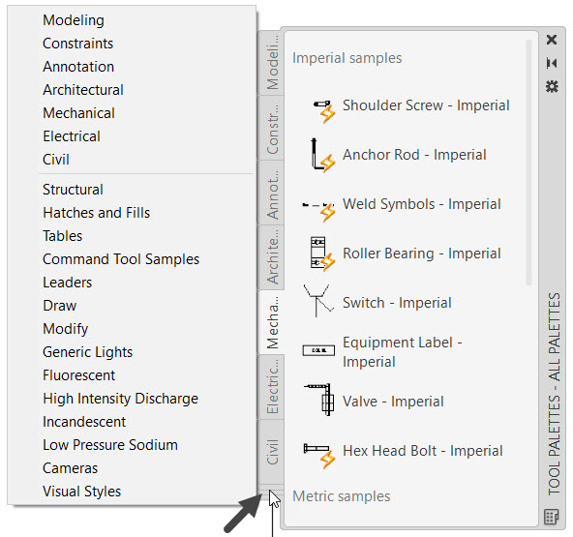
التعامل مع الكتل Using tools Palettes
You can arrange blocks, dimensions, hatch patterns and other frequently used tools in Tool Palettes. You can display the Tool Palettes by the clicking View → Palettes → Tool Palettes on the ribbon or entering TOOLPALETTES in the command line.
There are many palettes arranged in the TOOL PALETTES window. You can display more palettes by clicking the lower left corner of the Tool Palettes and selecting the required palettes.
There are many blocks available in the Architectural, Mechanical, Electrical, Civil, and Structural palettes. You can drag and place blocks from these palettes.

Slide 6
التعامل مع الكتل Inserting Multiple Blocks
You can insert multiple instances of a block at a time by using the MINSERT command. This command is similar to the ARRAY command:
• Type MINSERT in the command line and press ENTER; the message, “Enter block name or [?]:” appears.
• Type block name and press ENTER; the block is attached to the cursor.
• Pick a point in the drawing window.
• Enter 1 as the scale factor.
• Enter 0 as the rotation angle; the message, “Enter number of rows (---) <1>:” appears.
• Enter 1 as the row value; the message, “Enter number of columns (|||) <1>:” appears.
• Enter 4 as the column value; the message, “Specify distance between columns (|||):” appears.
• Type the distance and press ENTER; the block will be inserted like array command.

Slide 7
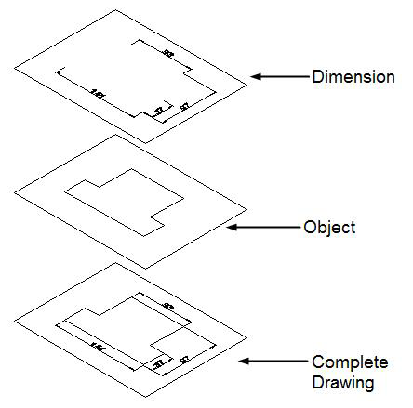
التعامل مع الطبقات Layers
Layers are like a group of transparent sheets that are combined into a complete drawing. The figure displays a drawing consisting of object lines and dimension lines. In this example, the object lines are created on the ‘Object’ layer, and dimensions are created on the layer called ‘Dimension’. You can easily turn-off the ‘Dimension’ layer for a clearer view of the object lines.
Layer Properties Manager
The Layer Properties Manager is used to create and manage layers. To open Layer Properties Manager, click Home → Layers → Layer Properties on the ribbon or enter LA in the command line

Slide 8
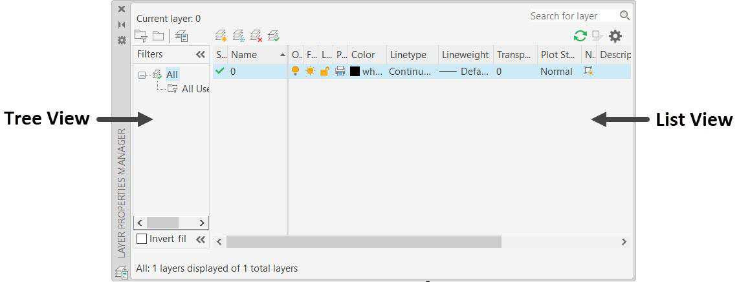
التعامل مع الطبقات Layers
The components of the Layer Properties Manager are shown below. The Tree View section is used for displaying layer filters, group, or state information. The List View section is the main body of the Layer Properties Manager. It lists the individual layers that currently exist in the drawing.
The List View section contains various properties. You can set layer properties and perform various operations in the List View section. A brief explanation of each layer property is given below.

Slide 9
التعامل مع الطبقات Layers
Status –Shows a green check when a layer is set to current.
Name - Shows the name of the layer.
On – Used to turn on/off the visibility of a layer. When a layer is turned on, it shows a yellow light-bulb. When you turn off a layer, it shows a grey light-bulb.
Freeze/Thaw – It is used to freeze the objects of a layer so that they cannot be modified. Also, the visibility of the object is turned off.
Lock/Unlock- It is used to lock the layer so that the objects on it cannot be modified.
Color – It is used to assign a color to the layer.
Linetype – It is used to assign a linetype to the layer.
Lineweight – It is used to set a lineweight (thickness) to the layer.
Transparency – It is used to set transparency to a layer. You set a transparency level from 0 to 90 for all objects on a layer.
Plot Style – It is used to override the settings such as color, linetype, and lineweight while plotting a drawing.
Plot – It is used to control which layer will be plotted.
New VP Freeze – It is used to create and freeze a layer in any new viewport.
Description – It is used to enter a detailed description about the layer.

Slide 10
التعامل مع الطبقات Layers
Creating a New Layer : You can create a new layer by using anyone of the following methods:
• Click the New Layer button on the Layer Properties Manager; a new layer with the name ‘Layer1’ appears in Name field. Next, enter the name of the layer in the Name field.
• Right-click in the Name field and select New Layer from the shortcut menu.
• If you want to continue to create layers after creating one layer, then press ENTER or comma (,).
Making a layer current
If you want to draw objects on a particular layer, then you have to make it current. You can make a layer current using the methods listed below.
• Select the layer from the List view and click the Set Current button on the Layer Properties Manager.
• Double-click on the Name field of the layer.
• Right-click on the layer and select Set current.
Deleting a Layer
You can delete a layer by using anyone of the following methods:
• Click the Delete Layer button or press ALT+D.
• Right-click in the Name field and select Delete Layer from the shortcut menu.
You will learn more about layers in later chapters. You can find an example related to layers in the Offset tool section of chapter 4.

Slide 11
الدرس القادم ... AutoCAD 2021
في الدرس القادم ... مراجعة عامة ... بإذن الله
شكراً جزيلا

